Slide 1
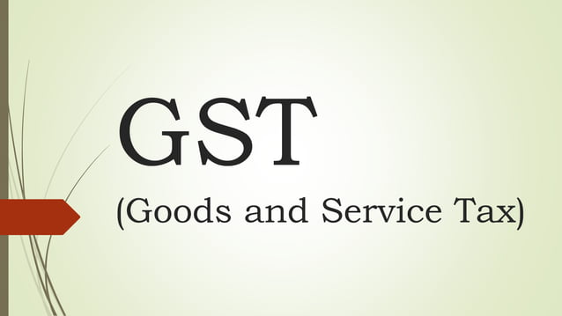
Presented by – MANPREET SINGH

Slide 2
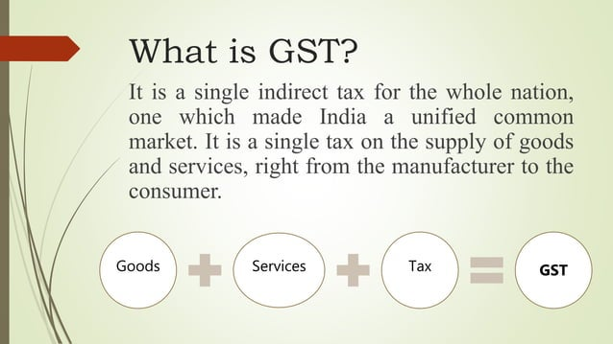

Slide 3
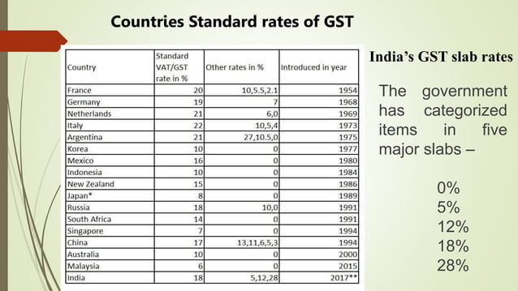

Slide 4
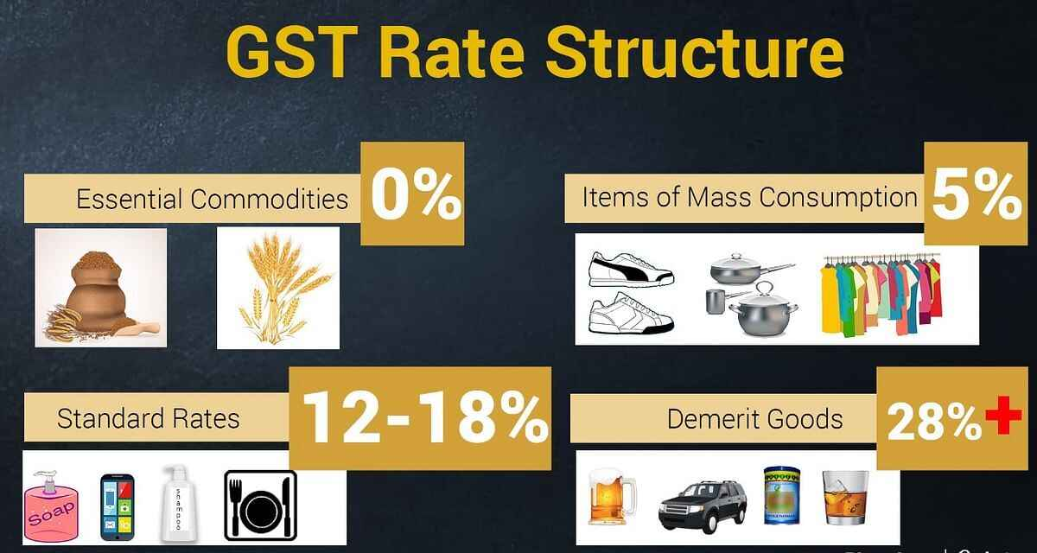

Slide 5
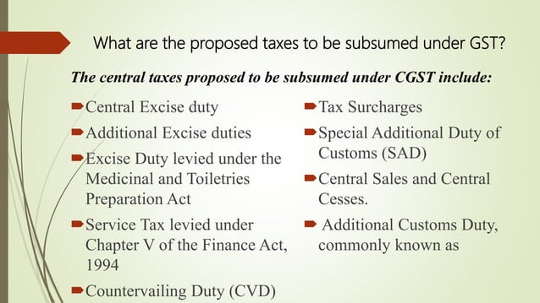

Slide 6
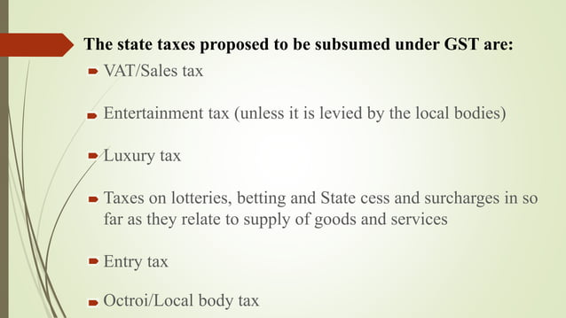

Slide 7
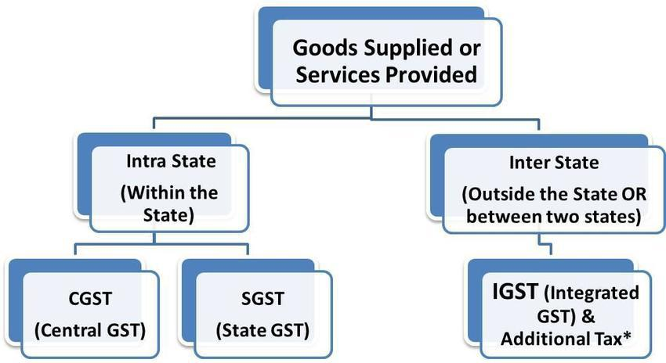

Slide 8
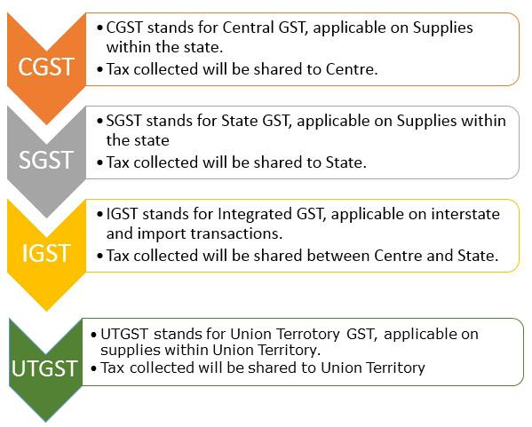

Slide 9
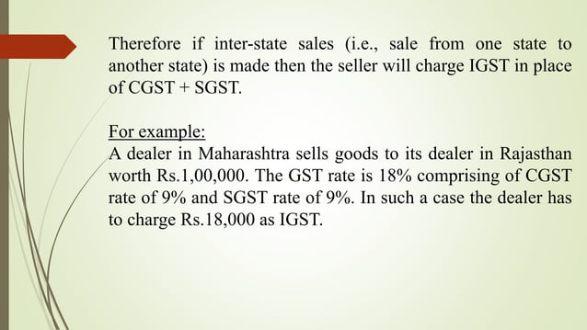

Slide 10
ILLUSTRATION OF GST
Product A | VAT System | GST System
Base Price | 100 | 100
+12% Excise Duty | 12 | NA
+12.5% VAT | 14 | NA
State GST | NA | 8
Centre GST | NA | 12
TOTAL TAX | 26 | 20
Value of Product for Customer - | 126 | 120

Slide 11
ADVANTAGES OF GST
A. Benefits to Government:
Increase in Revenue collection
Simple & Easy to Administer (IT System)
Better control on leakage(Input tax credit)
Reduction in inflation
Investment boosting & more employment

Slide 12
B. Benefits to Business & Industry
Easy Compliance (Registration, Returns, payments online)
Uniformity in tax rates & structures (Calculation)
Composition scheme for small business (Fixed rate)
Elimination of multiple taxes
Less corruption
Easy for e- business
C. Benefits To Consumer/customer
Single & Transparent tax
Cheaper Goods

Slide 13
DISADVANTAGES/ OBJECTIONS OF GST
High rate of taxes
Higher Threshold limit for Registration (₹40 lac)
No new system(Old wine in new Bottle)
Fear of loss of revenue (manufacturing states)
Difficulty in implementation (new infrastructure)
Left out certain items (Petroleum, Alcohol, Tobacco)
Came in middle of Financial Year

Slide 14


